Slide 1
Software Requirements Elicitation
Dr John H Robb, PMP, IEEE SEMC
UT Arlington
Computer Science and Engineering

Slide 2
Key Takeaway Points
Requirements are capabilities that the system must deliver.
The hardest single part of building a software system is deciding precisely what to build—i.e., the requirements. (Frederick P. Brooks, Jr.)
Requirements are the main challenge in developing software - this is the problem area!
Software requirements elicitation is aimed to identify the real requirements for the system – this may not be the same as what the customer asked for!
This module provides an overview of the requirements process and then focuses on the requirements elicitation - which is the emphasis of the textbook and requirements specification - which is the focus of the project

Slide 3
Overview of the Requirements Process
(c) JRCS 2016

Slide 4
The Requirements Process
The Requirements Process consists of the following steps
Requirements Planning (estimating requirements work)
Requirements Elicitation (draw-out the requirements)
Requirements Analysis (do they work and work together?)
Software Requirements Specification (capture requirements)
Requirements Validation
Requirements Management (requirements will change - they must be managed)
Requirements status reporting
Most of the industry is particularly weak in all but D and E above and many are weak here as well.
Questions to discuss:
What are typical software estimation measures and how do they apply to software requirements?
(c) JRCS 2016
Notes:
Answers to questions
1) SLOC is typically used as a size estimation factor - this is too late for requirements so we use immature requirements to estimate our work
2) See Barry Holchin's code growth model - also Galorath says that the typical code growth from Requirements to completion is 168 percent

Slide 5
Requirements in the Life Cycle
System Requirements
Software Acceptance Test
Software Requirements
Software Verification Test
Software High-level Design
Software Integration Test
Software Detailed Design
Software Integration Test
Software Coding
(c) JRCS 2016

Slide 6
Software Requirements Specification
Business
Goals/Objectives
Vision and Scope Document
User
Requirements
Quality
Attributes
Use Case Document
System
Requirements
Functional
Requirements
Constraints
Adapted from Karl Wiegers, Software Requirements
Software Requirements Specification
(c) JRCS 2016
1-6

Slide 7
Why Do We Manage Requirements ?
Distribution of Defects
Distribution of Effort to Fix Defects
Code
7%
Code
1%
Other
4%
Requirements
56%
Design
13%
Other
10%
Requirements
82%
Design
27%
(Martin & Leffinwell)
(c) JRCS 2016

Slide 8
Requirements Elicitation
The book concentrates mostly on Requirements Elicitation
Requirements are capabilities (stated as part of a contract) that the system must deliver.
Requirements are documented in a requirements specification, which serves as part of the contract.
Requirements elicitation is the process to identify and formulate the capabilities for the software system.
Identifying problems and needs
Constructing analysis models to help understanding
Formulating system/software requirements
Conducting feasibility study
Checking the requirements and models for desired properties such as correctness, and consistency
Specifying acceptance tests
Formulating an iterative development plan
(c) JRCS 2016

Slide 9
Typical Elicitation Mistakes
Noise
the presence of text that carries no relevant information to any feature of the problem.
Silence
a feature that is not covered by any text.
Over-specification
text that describes a feature of the solution, rather than the problem.
Contradiction
text that defines a single feature in a number of incompatible ways.
Ambiguity
text that can be interpreted in at least two different ways.
Forward reference
text that refers to a feature yet to be defined.
Wishful thinking
text that defines a feature that cannot possibly be validated.
Jigsaw puzzles
e.g. distributing requirements across a document and then cross-referencing
Inconsistent terminology
Inventing and then changing terminology
Putting the onus on the development staff
i.e. making the reader work hard to decipher the intent
Writing for the hostile reader
There are fewer of these than friendly readers
Source: Steve Easterbrook, U. of Toronto
(c) JRCS 2016

Slide 10
Requirements Problems Can Be Disastrous!
Insufficient requirements specification and their ad hoc management
Ambiguous and imprecise communication
Brittle architecture
Overwhelming complexity
Undetected inconsistencies in requirements, design, and implementation
Poor and insufficient testing
Subjective assessment of project status
Failure to attack risk
Uncontrolled change propagation
Insufficient automation
(c) JRCS 2016

Slide 11
Statistics from NIST Report
NIST (National Institute of Standards and Technology) has published a comprehensive (309 pages) and very interesting report on project statistics and experiences based on data from a large number of software projects¹
70% of the defects are introduced in the specification phase
30% are introduced later in the technical solution process
Only 5% of the specification inadequacies are corrected in the specification phase
95% are detected later in the project or after delivery where the cost for correction on average is 22 times higher compared to a correction directly during the specification effort
The NIST report concludes that extensive testing is essential, however testing detects the dominating specification errors late in the process
[1] http://www.nist.gov/public_affairs/releases/n02-10.htm (May 2002)
(c) JRCS 2016

Slide 12
Why Focus on Requirements ?
Distribution of Effort to Fix Defects
Distribution of Defects
Code
7%
Code
1%
Requirements
56%
Other
4%
Design
13%
Other
10%
Requirements
82%
Design
27%
Source: Martin & Leffinwell
(c) JRCS 2016

Slide 13
Back To Requirements Elicitation
(c) JRCS 2016

Slide 14
Challenges of Requirements Elicitation
"The hardest single part of building a software system is deciding precisely what to build. No other part of the conceptual work is as difficult as establishing that detailed technical requirements, including all the interfaces to people, to machines, and to other software systems. No other part of the work so cripples the resulting system if done wrong. No other part is more difficult to rectify later."
Frederick Brooks 1987

Slide 15
Challenges of Requirements Elicitation
As an analyst, I need to know what do you want?
But what do you want to do with the software?
I want you to design the software for me.
I don’t know until you tell me what the software can do.
Well, I can design the software to do anything!
Can you design the software to tell you my requirements?!

Slide 16
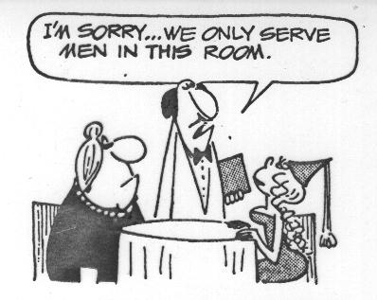
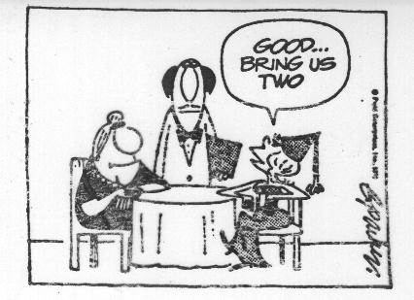
Communication Barrier - Misunderstanding

Slide 17
What is a Requirement?
Statement of some THING you want or need OR A characteristic of some THING you want or need
A requirement is also…
A Contractually Binding Statement
Documentation of Problem Space
The Means We Use to Communicate
Mutual
Understanding
(c) JRCS 2016

Slide 18
Types of Requirement
Functional requirements – statements of information processing capabilities that the software system must possess.
Nonfunctional requirements include
Performance requirements
Quality requirements
Safety requirements
Security requirements
Interface requirements

Slide 19
Examples of Functional Requirements
For a car rental system:
The system shall allow a potential customer to inquire information and availability of rental cars using various combinations of search criteria including make, model, from date, to date, price range, and class (small size, medium size, large size, and luxury cars).
For a study abroad system:
The system shall provide interactive as well as batch-processing means for an OIE (Office of International Education) staff to enter the exchange programs into the database.

Slide 20
Examples of Non-Functional Requirements
Workload:
The system shall be capable of handling a typical workload of 10,000 (ten thousand) inquiries at the same time.
Response time:
The system's response time shall not exceed 3 (three) seconds under the typical workload.

Slide 21
Examples of Constraints
A constraint is a limitation against the design or implementation (coding) space. These are not functional or non-functional requirements.
Development Methodology (sometimes specified by the customer)
The System/software shall use the Object Oriented methodology
The Software shall be coded in Java
What constraints will we have regarding the project?

Slide 22
Requirements Elicitation Steps
2. Construct analysis models, if desired.
1. Collect information about the application.
3. Derive requirements & constraints.
5. Review the requirements specification.
4. Conduct feasibility study.

Slide 23
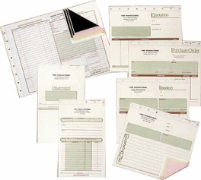


Information Collection Techniques
business
forms
operating
procedures
regulations &
standards
Customer presentation
Literature survey
Writing user stories
Stakeholder survey
User interviewing

Slide 24
Focuses of Information Collection Activities
What is the business, the current business situation, and how does it operate?
What is the system’s environment or context?
What are existing business processes, their input and output, and how do they relate to each other?
What are the problems with the current system?
What are the business or product goals?
Who are the users of the current and future systems, respectively?
What do the customer and users want, and what are their business priorities?
What are the quality, performance, and security considerations?

Slide 25
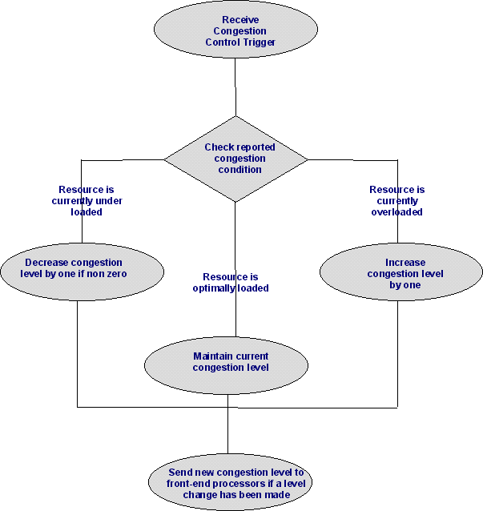
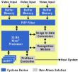

Constructing Analysis Models
fac
xxx
vvv
bbb
nnn
Intuitive models
fac1
fac2
Purpose: to aid understanding
of the application, requirements,
and constraints.
yyy
jjj
Formal or informal models

Slide 26





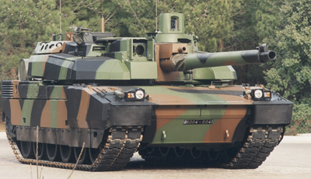






Businesses in Different Domains
Finance
Insurance
Health Care
Transportation
Defense
Telecommunication
Retailing
and more
government
Education
Energy
Manufacturing

Slide 27

Deriving Requirements and Constraints
Current Situation
Discrepancies/
Problems
Industry standards
and government
policies
Business Goals
Needs & wish list
Software Requirements Specification
Requirements & constraints

Slide 28
Requirements Specification Details
(c) JRCS 2016

Slide 29
Requirements Specification
3.1.1 User Interfaces
3.1.2 Hardware Interfaces
3.1.3 Software Interfaces
3.1.4 Communication Interfaces
3.2 Functional Requirements
3.2.1 Class 1
3.2.2 Class 2
3.2.3 ...
3.3 Performance Requirements
3.4 Design Constraints
3.5 Quality Requirements
3.6 Other Requirements
4. Appendices
IEEE SRS Standard by Objects, 1998
1. Introduction to Document
1.1 Purpose of Product
1.2 Scope of Product
1.3 Acronyms, Abbreviations, Definitions
1.4 References
1.5 Outline of the Rest of the SRS
2. General Description of Product
2.1 Context of Product
2.2 Product Function
2.3 User Characteristics
2.4 Constraints
2.5 Assumptions and Dependencies
3. Specific Requirements
3.1 External Interface Requirements
(c) JRCS 2016

Slide 30
Feasibility Study
Not all projects are practically doable with technology, time, and resource constraints.
Feasibility study aims at determining if the project is doable under the given constraints.
Feasibility study in RE is concerned with
the feasibility of the functional, performance, nonfunctional, and quality constraints
adequacy of the technology
timing and cost constraints
constraints imposed by the customer, industry and government agencies

Slide 31
Three Types of Requirements Review
Technical review is an internal review performed by the technical team. Techniques include:
peer review - peers perform informal “desktop reviews” sometimes guided by a review questionnaire
walkthrough - the analyst explains each requirement while the reviewers examine it and raise doubts
inspection - inspector is guided by a checklist of commonly encountered problems in SRS (e.g., incompleteness, duplicate definition, inconsistency, etc.)
In every case there is a requirement for period of time between which the review materials are available and the review is held – to allow for the pre-review (this is where most errors are found)
(c) JRCS 2016

Slide 32
Three Types of Requirements Review
Additional reviews (these are validation activities)
Expert review means review of the requirements specification by domain experts.
Customer/user reviews are performed by involving the customer and/or users of the system.
(c) JRCS 2016

Slide 33
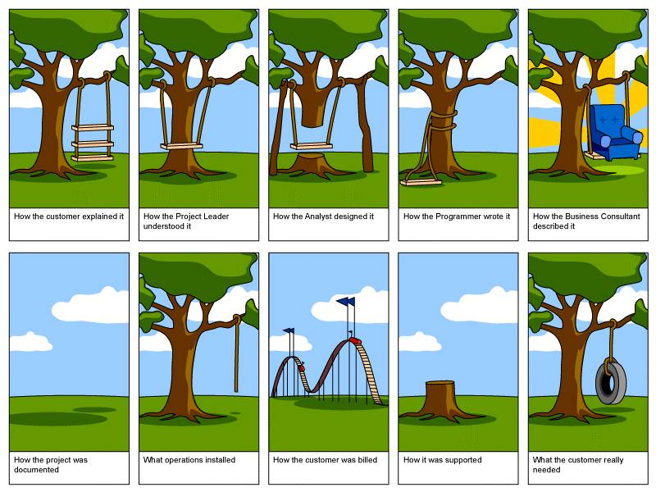
What is the right system to build ?

Slide 34
Quality Requirement Characteristics
Prioritized
Unambiguous
Verifiable
Correct
Feasible
Necessary

Slide 35
Necessary Requirement
Something the customer really needs
Something required for conformance to external requirement, external interface, or standard
Should be traceable back to its source
Source should be someone authorized to specify requirements
Untraceable requirements may not really be necessary
Estimates are that over 30% of most software requirements are capabilities that the user never asked for
"Gold plating"
Notes:
Adding unnecessary requirements is called “gold plating”.

Slide 36
Module Summary: Requirements The Basics
Requirements define the problem to be solved and establish the terms by which mission success will be measured.
Requirements problems are the single biggest problem on development projects so care in creating good requirements always pays off.
The later a problem is discovered the more costly it is to recover from.
Requirements are distributed within the system architecture via flow-down, allocation and derivation.
Requirements traceability is a technique of tracking the source and connections between requirements. It is used to assess the consequences of potential requirements changes.
When a system is decomposed into smaller segments, interfaces are created that must be defined and managed.
(c) JRCS 2016

Slide 37
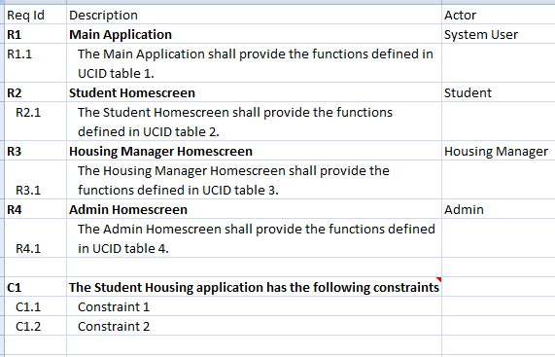
Requirements and the Class Project
Start with your analysis functions
Use the requirements template to scope the requirements tables (UCID)

Slide 38
Requirements and the Class Project
Develop the flow of the application using the UCID tables - notice that we have added the Starts from and Ends On columns
Visualize the Homescreen/Main Application
Click “Select” functions from these
Input data when prompted and Submit
Provide some sort of confirmation (see checklist)
Where do you go after this?

Slide 39
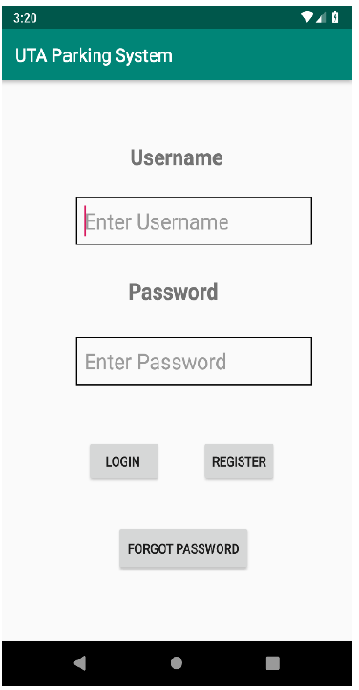
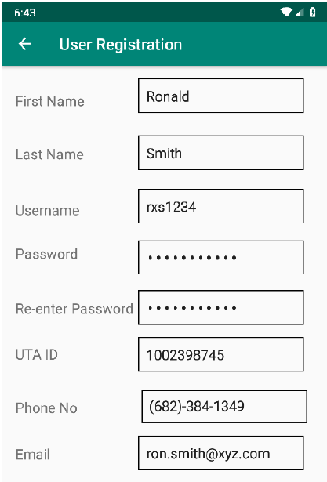

Requirements and the Class Project (cont.)
UTA Housing System
Main Application screen
Select Register
Go to Registration screen
Fill in data
Click Register

Slide 40
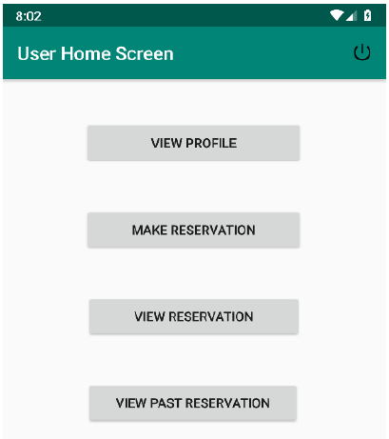

Requirements and the Class Project (cont.)
User Homescreen
Select a function
Enter data
Receive confirmation
Where do you go?

Slide 41
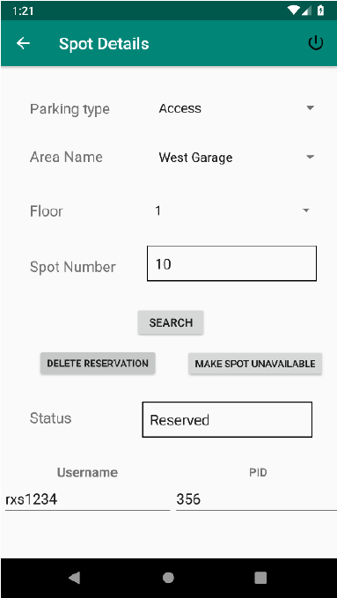
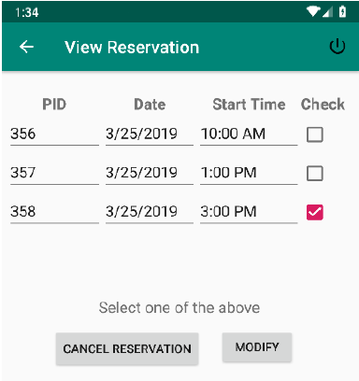

Requirements and the Class Project (cont.)
Apt details
Apt type
Non furnished
Two different kinds of outputs: lists and details.
The left is a list - it provides a summary.
To the right is a specific item in the list.
The list has to provide the ability to select an individual item
Apt Name
Vintage Pads
Apt Number
Reserve
Modify
Unreserved

Slide 42
Requirements and the Class Project (cont.)
What you are doing for the requirements is laying out the
Inputs
Outputs
Processing (sorting on what and how/confirmation & redirect)
Application Flow (UCID tables)

